Slide 1
INT428 ARTIFICIAL INTELLIGENCE ESSENTIALS
Lecture #0
A kick start session

Slide 2
Course details
LTP – 3 0 1
Credits – 4.0
Text Books:
1. ARTIFICIAL INTELLIGENCE by RICH, KNIGHT, MCGRAW HILL EDUCATION
References:
1. ARTIFICIAL INTELLIGENCE AND INTELLIGENT SYSTEM by N. P. PADHY, OXFORD UNIVERSITY PRESS
2. INTRODUCTION TO GENERATIVE AI by NUMA DHAMANI AND MAGGIE ENGLER, Manning Publications.

Slide 3
School Vision
To be a globally recognized school through excellence in teaching, learning and research for creating Computer Science professionals, leaders and entrepreneurs of future contributing to society and industry for sustainable growth.

Slide 4
School Mission
To build computational skills through hands-on and practice-based learning with measurable outcomes.
To establish a strong connect with industry for in-demand technology driven curriculum.
To build the infrastructure for meaningful research around societal problems.
To nurture future leaders through research-infused education and lifelong learning.
To create smart and ethical professionals and entrepreneurs who are recognized globally.

Slide 5
Course Outcomes
CO1:: describe basic knowledge representation, problem solving, and learning methods of artificial intelligence.
CO2:: compare uninformed and informed search strategies to solve AI problems.
CO3:: discuss knowledge representation and statistical reasoning methods for AI.
CO4:: analyze different AI strategies for game playing and NLP essentials.
CO5:: explain Generative AI fundamentals and prompt engineering for crafting effective prompts.
CO6:: apply the learned skills and techniques through hands-on tasks that involve a combination of GPT tools, data analysis, visualization, and presentation creation.

Slide 6
Program Outcomes
PO1::Apply the knowledge of mathematics, science, engineering fundamentals, and an engineering specialization to the solution of complex engineering problems.
PO2::Identify, formulate, review research literature, and analyse complex engineering problems reaching substantiated conclusions using first principles of mathematics, natural sciences and engineering sciences.
PO3::Design solutions for complex engineering problems and design system components or processes that meet the specified needs with appropriate consideration for the public health and safety, and the cultural, societal, and environmental considerations.
PO4::Use research-based knowledge and research methods including design of experiments, analysis and interpretation of data, and synthesis of the information to provide valid conclusions.
PO5::Create, select, and apply appropriate techniques, resources, and modern engineering and IT tools including prediction and modelling to complex engineering activities with an understanding of the limitations.

Slide 7
Program Outcomes (Cont.)
PO6::Apply reasoning informed by the contextual knowledge to assess societal, health, safety, legal and cultural issues and the consequent responsibilities relevant to the professional engineering practice.
PO7::Understand the impact of the professional engineering solutions in societal and environmental contexts, and demonstrate the knowledge of, and need for sustainable development.
PO8::Apply ethical principles and commit to professional ethics and responsibilities and norms of the engineering practice.
PO9::Function effectively as an individual, and as a member or leader in diverse teams, and in multidisciplinary settings.
PO10::Communicate effectively on complex engineering activities with the engineering community and with society at large, such as, being able to comprehend and write effective reports and design documentation, make effective presentations, and give and receive clear instructions.

Slide 8
Program Outcomes (Cont.)
PO11::Demonstrate knowledge and understanding of the engineering and management principles and apply these to one’s own work, as a member and leader in a team, to manage projects and in multidisciplinary environments.
PO12::Recognize the need for, and have the preparation and ability to engage in independent and lifelong learning in the broadest context of technological change.

Slide 9
Program Specific Outcomes
PSO1::Apply basic knowledge in the areas such as Software Engineering, Networking and Security, Database Management Systems, Intelligent Systems, Operating Systems and System Architecture for building Software products.
PSO2::Provide effective and efficient real time solutions using attained knowledge in inter-disciplinary domains for societal benefits through projects.

Slide 10
CO-PO Mapping
CO/PO | PO1 | PO2 | PO3 | PO4 | PO5 | PO6 | PO7 | PO8 | PO9 | PO10 | PO11 | PO12
CO1 | 3 | 2
CO2 | 3 | 3 | 2
CO3 | 2 | 3 | 3
CO4 |  | 2 | 3 | 3 | 2
CO5 |  |  | 2 | 3 | 3
CO6 |  |  | 2 | 2 | 3 | 3 | 2 | 3 | 3 | 3 | 2 | 2

Slide 11

The hitch…
The two BURNING questions in mind…
Why are we learning Artificial Intelligence Essentials?
What would we do with it?

Slide 12
Need of Artificial Intelligence?
The need for AI:
Automation of Repetitive Tasks
Data Analysis and Insights
Enhanced Decision Making
Improved Customer Experience
Medical Advancements
Security and Fraud Detection
Smart Infrastructure and Cities
Innovations in Education
Agricultural Improvements
Economic Growth and Competitiveness

Slide 13
Course Focus
Placements
Research
Higher Studies

Slide 14
Mapping of Course with Cohort
Machine Learning

Slide 15
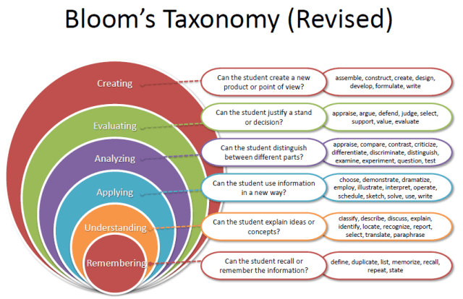
Revised Bloom’s Taxonomy

Slide 16
Course contents
Before MTE
UNIT-I
Introduction: What is intelligence? what is artificial intelligence? Foundations of artificial intelligence(AI), History of AI, Basics of AI, Artificial Intelligence Problems, Artificial Intelligence Techniques, applications of AI, branches of AI, Modern AI tools and their Applications
Problem Spaces and Search: Defining the problem as a state space search, Production systems, Problem characteristics, Production system characteristics, Issues in designing search problems

Slide 17
UNIT-II
Before MTE
Uninformed Search Strategies: Breadth first search (BFS), Depth first search (DFS), Bidirectional Search, Iterative Deepening
Informed Search Strategies: Heuristic functions, Generate and Test, Hill Climbing, Simulated Annealing, Best first search, A* algorithm, Constraint satisfaction

Slide 18
UNIT-III
Before MTE
Knowledge Representation: Approaches in knowledge representation, Issues in knowledge representation, Propositional logic, Predicate logic, Forward versus backward reasoning
Statistical reasoning methods: Probability & Bayes' theorem, Bayesian networks, Dempster Shafer-Theory, Certainty factors & rule-based systems

Slide 19
UNIT-IV
After MTE
Game playing: Evaluation function, Minmax Problem, The min-max search procedure, Alpha-beta cutoffs, Alpha-beta pruning
Natural Language Processing: introduction to NLP, NLP phases, construction of parse tree, Spell checking, bag of words model, Soundex algorithm, Applications of NLP, Chatbots, Alexa, siri, Cortana

Slide 20
UNIT-V
After MTE
Introduction to Generative AI: Fundamentals of Generative AI, Generative AI model types, How Gen AI works, Difference between GPTs and search engines
Prompt Engineering: fundamentals of prompt, importance of prompt engineering, Overview of language models, Key elements of a good prompt, prompt patterns, prompt tuning

Slide 21
UNIT-VI
After MTE
ChatGPT Advance Data Analysis: ChatGPT Advanced Data Analysis vs. ChatGPT, Building Data Visualization and Creating a Presentation, working with structured data, working with media, Zip files for automation, working with small documents, appropriate use of ChatGPT Advanced Data Analysis, Human and AI Process planning, Error identification techniques, error handling
Advanced topics in Artificial Intelligence : Machine Learning and its types, Overview of Neural Networks, Overview of Genetic Algorithms, Overview of Fuzzy Logics

Slide 22
List of Practicals:
Implement state space search and production system to solve water jug problem.
Implement Breadth First Search (BFS) and Depth First Search (DFS).
Implement Best first search on a given problem.
Using AI tools for content creation and editing of text and presentation.
Using AI tools for image, audio and video editing.
Implement Bayes theorem and Bayesian network and perform inference.
Implement the Minimax algorithm with Alpha-Beta pruning for a simple game.
Create a web application where users can drag and drop documents to get AI-generated summaries.
Implement a chatbot to automate customer support for common queries.
Use ChatGPT Advanced Data Analysis to build data visualizations and create presentations based on structured data.

Slide 23
Course Assessment Model
Marks break up
Attendance 5
Continuous Assessment 45
ETT 50
Total 100

Slide 24
Details of Academic tasks
Type of Assessmentl | Type of Assessment e.g. Test/Term Paper/project etc. | Details of academic task | Parameters/Rubric of Evaluation | External/Internal | Allotment Week
CA1 | Skill based test-Patent Filing | Student will present his patent Idea or prototype and stage if filling | 1. IPR description (10) 2. Originality and Innovation (15) 3. Patent Proposal Submission to RDC (5) 4. Acceptance from RDC (5) 5. Presentation and Question Answers (15) | Internal | 3rd /10th week
CA2 | Test | Standard AI approach based Questions | Test | Internal | 5th /6th week
CA3 | Skill based test- AI tool Usage | Student will make a small AI product like chatbot using modern Gen AI tools, Hands on Tasks(HOT) | 1. Understanding of Tool (5) 2. Implementation Skills (10) 3. Problem Solving (15) 4. Project Output Quality (5) 5. Explanation (15) | Internal | 8th /11th week

Slide 25
Star Course:
Hands-on Practice: This star course includes interactive coding exercises to help you apply what you've learned. It covers core and advanced AI concepts like problem-solving, search strategies, machine learning, NLP, and generative AI, equipping students with practical skills in AI tools and data analysis. The course prepares students for real-world applications and career opportunities.

Slide 26
OPEN EDUCATIONAL RESOURCE
Unit mapped | Broad topic | Source URL
Unit 1 | Introduction to AI, Problem Spaces and Search | https://www.geeksforgeeks.org/artificial-intelligence-an-introduction/, https://www.baeldung.com/cs/state-space-search#:~:text=2.,state%2C%20and%20the%20goal%20state, https://www.synthesia.io/post/ai-tools https://www.aec.edu.in/aec/Instruction_Material/AI%20-%20UNIT-1.pdf
Unit 2 | Uninformed Search Strategies Informed Search Strategies | https://www.javatpoint.com/ai-uninformed-search-algorithms, https://simplilearn.com/tutorials/artificial-intelligence-tutorial/heuristic-function-in-ai, https://www.geeksforgeeks.org/generate-and-test-search/, https://www.geeksforgeeks.org/introduction-hill-climbing-artificial-intelligence/, https://www.geeksforgeeks.org/simulated-annealing/, https://www.geeksforgeeks.org/best-first-search-informed-search/, https://www.javatpoint.com/ai-informed-search-algorithms, https://www.geeksforgeeks.org/constraint-satisfaction-problems-csp-in-artificial-intelligence/

Slide 27
OPEN EDUCATIONAL RESOURCE
Unit 3 | Knowledge Representation, Statistical reasoning methods | https://medium.com/@dpthegrey/representations-and-mappings-b4b4d1baf710, https://www.javatpoint.com/knowledge-representation-in-ai, https://www.scribd.com/document/520640909/Issues-in-knowledge-representation, https://www.javatpoint.com/propositional-logic-in-artificial-intelligence, https://www.javatpoint.com/predicate-logic, https://www.geeksforgeeks.org/difference-between-procedural-and-declarative-knowledge/, https://www.virtusa.com/digital-themes/logic-programming, https://www.tutorialspoint.com/difference-between-forward-and-backward-reasoning-in-ai https://www.geeksforgeeks.org/bayes-theorem-in-artificial-intelligence/, https://www.javatpoint.com/bayesian-belief-network-in-artificial-intelligence, https://geeksforgeeks.org/ml-dempster-shafer-theory/, https://www.brainkart.com/article/Certainty-Factors-in-Rule-Based-Systems_8589/, ,

Slide 28
OPEN EDUCATIONAL RESOURCE
Unit 4 | Game Playing, Natural Language Processing | https://www.geeksforgeeks.org/game-playing-in-artificial-intelligence/, https://www.javatpoint.com/mini-max-algorithm-in-ai, https://ebooks.inflibnet.ac.in/itp6/chapter/alpha-beta-cutoffs/, https://www.javatpoint.com/ai-alpha-beta-pruning, https://www.twilio.com/en-us/blog/nlp-steps, https://www.geeksforgeeks.org/syntax-tree-natural-language-processing/, https://www.geeksforgeeks.org/how-to-deal-with-spelling-errors-in-nlp/, https://www.geeksforgeeks.org/bag-of-words-bow-model-in-nlp/, https://medium.com/aimonks/the-soundex-algorithm-bridging-phonetics-and-data-8e6f7380e84d, https://www.geeksforgeeks.org/top-7-applications-of-natural-language-processing/, https://medium.com/@springboard_ind/natural-language-processing-use-case-alexa-siri-cortana-springboard-india-blog-f6245f132696

Slide 29
OPEN EDUCATIONAL RESOURCE
Unit 5 | Introduction to Generative AI, Prompt Engineering | https://www.coursera.org/learn/introduction-to-generative-ai, https://www.coursera.org/learn/prompt-engineering
Unit 6 | ChatGPT Advance Data Analysis, Advanced topics in Artificial Intelligence | https://www.coursera.org/learn/chatgpt-advanced-data-analysis, https://www.geeksforgeeks.org/ml-machine-learning/, https://aws.amazon.com/what-is/neural-network/, https://www.geeksforgeeks.org/genetic-algorithms/, https://www.geeksforgeeks.org/fuzzy-logic-introduction/

Slide 30
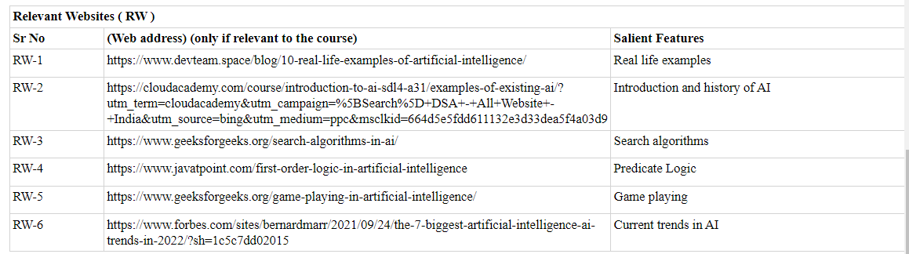

READING MATERIAL

Slide 31

Follow this for getting instant solution for your Academic queries:

